Slide 1
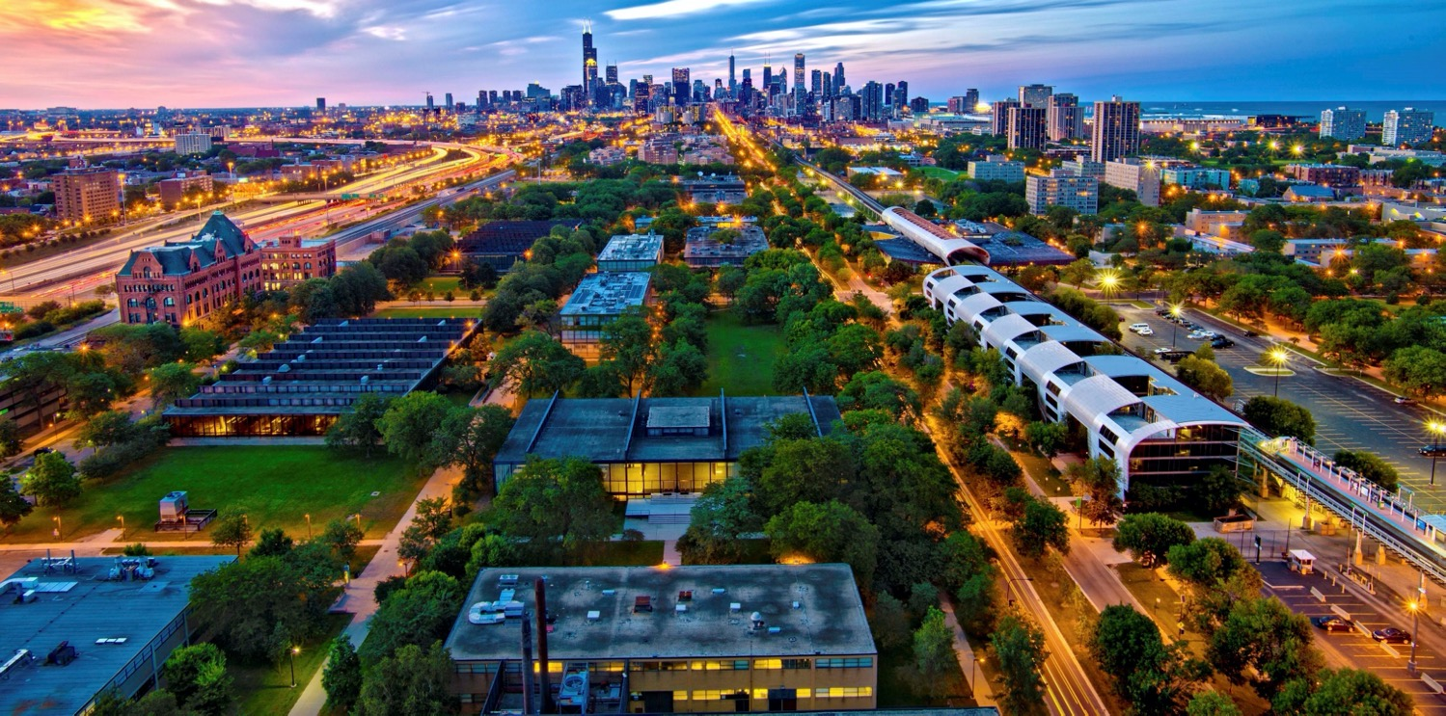
REFERENTE: PROF. ILARIA GIANNOCCARO

Slide 2
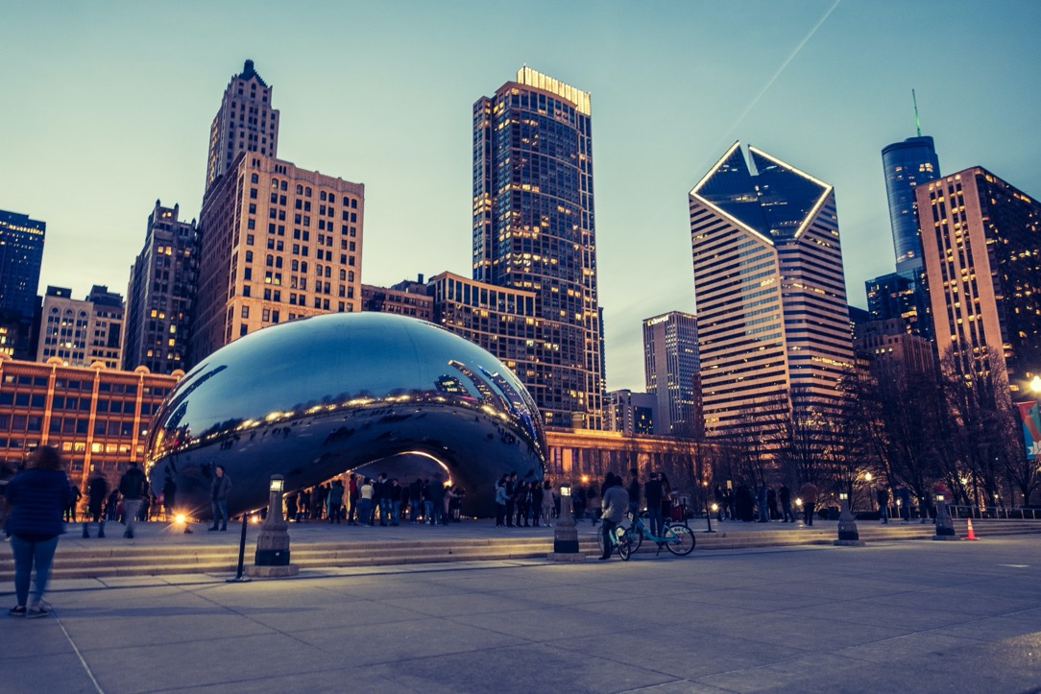
This is Chicago
Dynamic city of 3 million people
Metropolitan area of 10 million people
The birthplace of the skyscraper and of “modern” architecture
The style known as modern architecture was born at the Illinois Institute of Technology

Slide 3
Financial Hub
A world leader in derivatives markets, high frequency trading
Home to many leading companies, including (but not limited to) insurance, technology, and agri-business
Chicago is the birthplace of organized options trading, and modern futures contracts

Slide 4
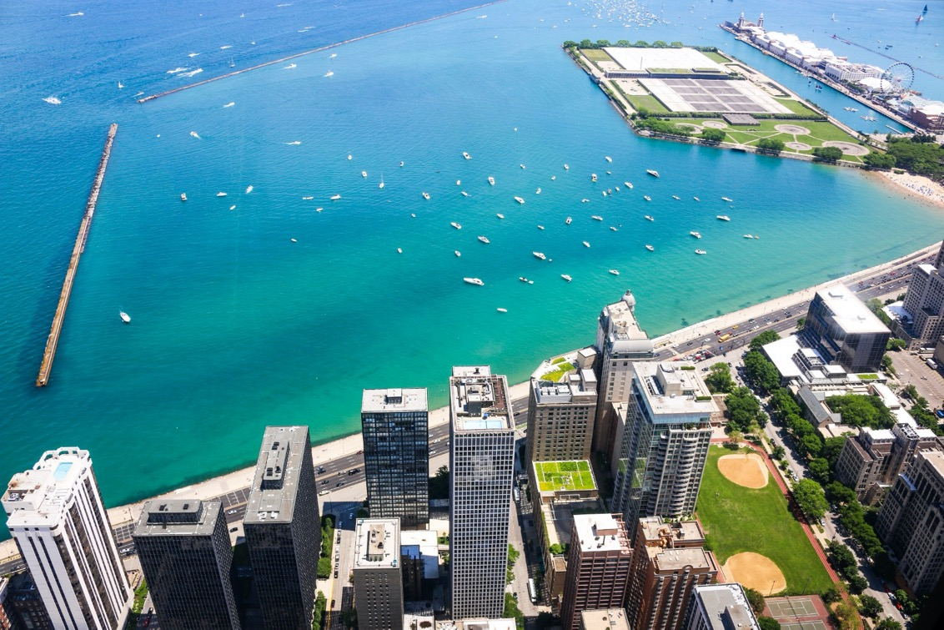
This is also Chicago
Tranquil Lake front beaches, miles of bike trails, and beautiful parks

Slide 5
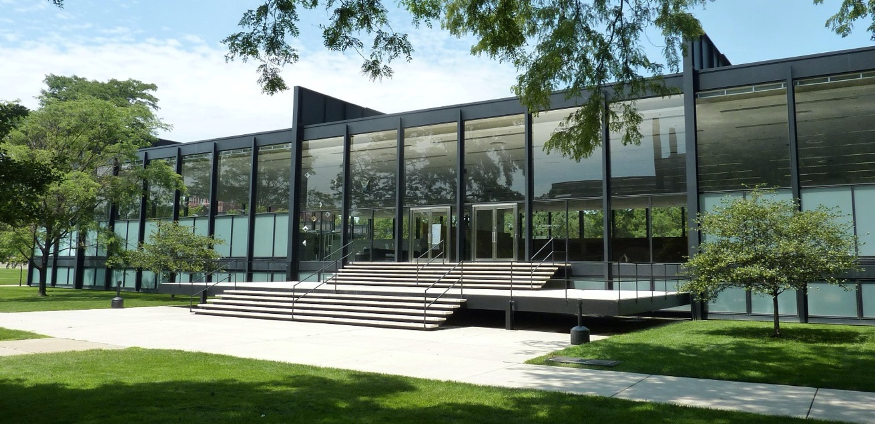
This is Illinois Tech
Mid-sized, private, tier 1 research university
The main campus is a tribute to the father of modern architecture (Mies van der Rohe, former faculty member)
Three train lines run through campus, connecting it to all parts of the city

Slide 6
The Business and Law School are right downtown in their own building less than ½ mile (1 km) from the Financial District and about 3 miles (5 km) from the main campus. Classes will be held at this location.
Classes run from 6:00pm to 8:30pm
Leaving the day free for you to pursue internships, business networking, or catching up on study in the library pictured here.

Slide 7
Academic Departments @ Illinois Tech
Stuart School of Business
Armour College of Engineering
Chicago-Kent College of Law
College of Science
College of Architecture
Institute of Design
Lewis College of Human Sciences
School of Applied Technology

Slide 8
M.S. in Environmental Management & Sustainability Program
The EMS. program integrates law, science and business to answer the increasing demand for management professionals capable of leading in this sector by collaborating with scientists and engineers to find environmentally-conscious business solutions.
Graduates work in environmental sustainability and compliance management as consultants, analysts, entrepreneurs, and professionals who can successfully make the business case for sustainability.
The EMS program is a STEM designated program

Slide 9
M.S. in Finance Program
The M.S. in Finance program builds on a solid foundation in financial mathematics, statistics, and modeling to prepare students for specialized careers in the financial services industry.
Students benefit from Chicago’s status as a leading financial center.
Courses are taught by industry experts who bring their career knowledge and understanding of today’s marketplace directly to the classroom.
Partnerships with alumni and other professionals in the industry give students numerous opportunities to work on real-world projects and gain valuable professional experience.
Ranked 5th in the U.S. and 42nd globally by Financial Times (2018)
Ranked 22nd in the U.S. in Finance programs by TFE Times (2018)

Slide 10
STUART CAREER MANAGEMENT CENTER (CMC)
Services offered by Stuart CMC to students
Open advising hours and advising appointments
Career Pathways and Company Visits
Resume guide, cover letter guide, and interviewing guide
Career Assessment tools
Curricular Practical Training (CPT), internship, and coop information

Slide 11
Admission Standards for Dual Degree Programs
Completion of core graduate program courses at the PoliBa;
A 3.0 Grade Point Average equivalent to a minimum score of 24 at PoliBa
2 letters of recommendation;
Resume;
Financial support form;
Copy of passport identity page;
Certified transcripts in English and Italian of the first semester of the first year of study at PoliBa;
Certified proof of the Bachelor’s degree equivalent in English; and
A short professional statement.

Slide 12
Admission Standards for Dual Degree Programs
Test Scores for Master of Environmental Management and Sustainability Program.
GMAT score of 500 or a GRE score of 298.
An internet based TOEFL score of 85, a paper based TOEFL score of 600 or an IELTS score of 7.0
Test Scores for Master of Finance Program.
GMAT score of 600 or a GRE score of 310.
An internet based TOEFL score of 85, a paper based TOEFL score of 600 or an IELTS score of 7.0
GRE tests scores may be waived on a case-by-case basis if students can show proof of successfully passing the following subjects: Calculus 1, Calculus II up to Integration, Linear Algebra and Statistics (Analisi Matematica and Geometria e Algebra)

Slide 13
Application Deadlines and Contacts
Application Deadline for Fall 2020 Semester is April 15th
Visa Category for Degree Program = F1 Visa
Primary Contact for Information: Dr. Vanita Misquita, Director of IIT Overseas Programs at misquita@iit.edu
Questions about program content, contact Dr. Roland Calia at rcalia@stuart.iit.edu.
PoliBa Coordinator: Prof. I. Giannoccaro

Slide 14
DUAL DEGREE PLANS OF STUDY AT IIT STUART SCHOOL OF BUSINESS

Slide 15
Dual Degree Plans of Study
The IIT Stuart graduate degrees require completion of 11 courses.
The dual degree format allows 2 or 3 of these courses to count toward completion of both graduate degrees.
Minimum of 72 ECTS at PoliBa (1st year)
Minimum of 21 credits (42 ECTS) at IIT (2nd year)
The Master’s thesis is conducted at IIT (6 credits) under joint supervision. It has to be written in English language and fulfill the requirements of the Poliba

Slide 16
Dual Degree Plan of Study: Management Engineering & Environmental Management
Courses Taken In Residence at PoliBa (72 ECTS)
Fall semester
One course (6 ECTS = 3 credits)
Information systems (12 ECTS = 6 credits)
Innovation economics and management (12 ECTS = 6 credits)*
Environmental management of production systems (6 ECTS = 3 credits)*
Spring semester
Lean Production and Supply Chain Management (12 ECTS = 6 credits)
Continuous Improvement of Sustainable Manufacturing (12 ECTS = = 6 credits)
One course (6 ECTS = 3 credits)
English II (3 ECTS)
Tirocinio (3 ECTS)
* double counted

Slide 17
Dual Degree Plan of Study: Management Engineering & Environmental Management
Courses Taken In Residence at IIT (48 ECTS = 24 credits)
Fall Semester:
EMS 502: Environmental Law
EMS 504: Industrial Ecology
EMS 512: Environmental Risk Assessment
Spring Semester
EMS 503: Environmental Pollution Control
BUS 550 Business Analytics
SMGT 529 - Social Entrepreneurship
Summer Semester
EMS 597-01: Elective (Independent Study for thesis)
EMS 597-02: Elective (Independent Study for thesis)

Slide 18
Dual Degree Plan of Study: Management Engineering & Finance
Course Taken in Residence at PoliBa (72 ECTS)
Fall Semester (36 ECTS)
Management Accounting (3 credits = 6 ECTS)*
Business and sustainability (3 credits = 6 ECTS)*
Information systems (6 credits = 12 ECTS)
Finanza e Business Planning (6 credits = 12 ECTS)
Spring Semester (36 ECTS)
Strategy and Management (3 credits = 6 ECTS)*
Lean Production and Supply Chain Management or Continuous Improvement of Sustainable Manufacturing (6 credits = 12 ECTS)
2 courses (12 ECTS)
English II (3 ECTS)
Tirocinio (3 ECTS)
* double counted

Slide 19
Dual Degree Plan of Study: Management Engineering & Finance
Fall Semester
MSF 501 Mathematics with Financial Applications
MSF 502 Statistical Analysis in Financial Markets
MSF 503 Financial Modeling
Spring Semester
MSF 504 Valuation and Portfolio Management
MSF 505 Futures, Options and OTC Derivatives
MSF 506 Financial Statement Analysis
Summer Semester
MSF 597-01 Independent Study in Finance (Thesis)
MSF 597-02 Independent Study in Finance (Thesis)

Slide 20
Transcript of records
Grading System
NJIT grade | Significance | Points | Poliba grade
A = 4.0 | Excellent | 93-100 | 30 – 30 e lode
B+ = 3.5 | Good | 84-92 | 27-29
B = 3.0 | Acceptable | 76-83 | 24-26
C+ = 2.5 | Marginal Performance | 68-75 | 21-23
C = 2.0 | Minimum Performance | 60-67 | 18-20

